Slide 1

OpenAI Functions & LLM: Empowering HR Onboarding
Welcome to the world of OpenAI functions and how they can be leveraged for HR Onboarding. Get ready to dive into the exciting possibilities.
By Amit Mishra, Amit Basnak, Himani Singh

Slide 2
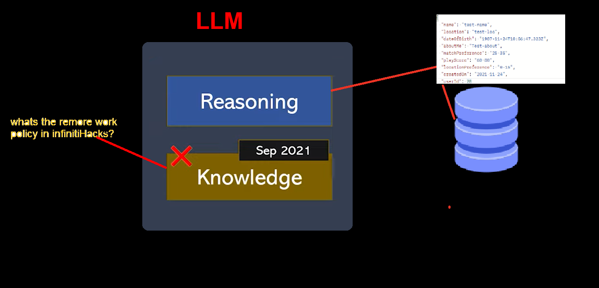
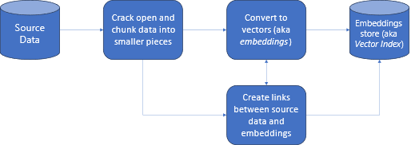
SOLUTION OVERVIEW
What is the Work policy in Infinity Hacks Bot ?
LLM
Below models we have used for training our Solution
LLM: Large Language Models
OpenAI Function Calling
NLP and GPT-3

Slide 3
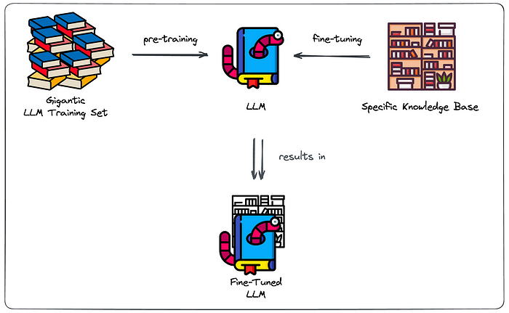
Why fine-tuning won’t always cut it?
Major challenges due to their pre-trained nature:
Struggle to provide coherent and accurate responses on topics they have not been trained on, especially content that is not publicly available.
Producing unreliable responses, often referred to as “hallucinations,” where they generate confidently incorrect information.
Crucial Problems
No source clarity: no clear distinction between “general” and “specific” knowledge.
No access restriction : can’t choose to leave out knowledge at inference time.
Hosting an LLM is costly : Costs to keep it up and running
Fine-tuning repetitions : retraining is required when you want the model to reflect changes to the knowledge base.

Slide 4
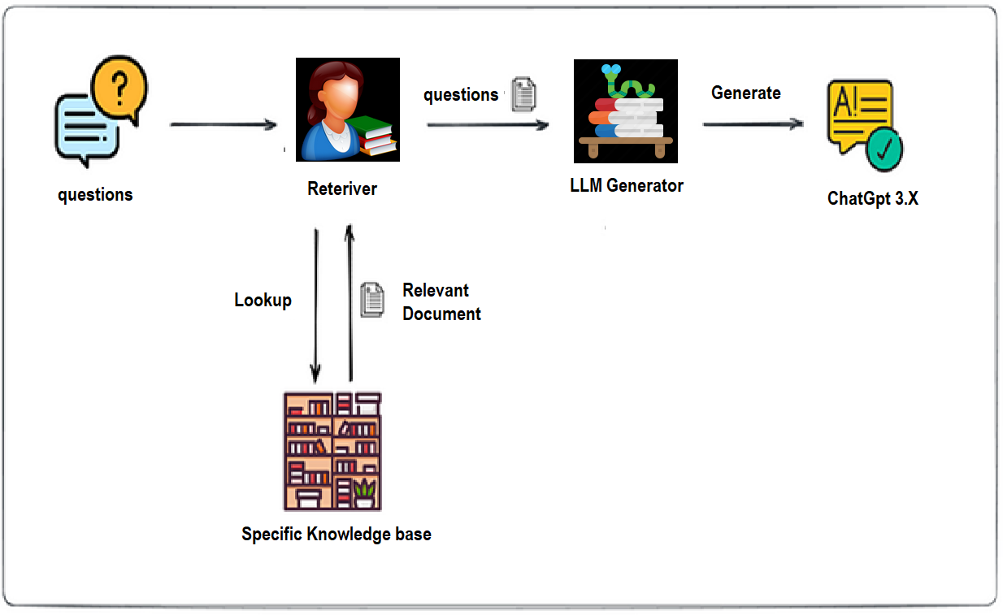
Future of MVP Developed Using LLM/RAG
Retrieval-Augmented Generation (RAG) :
Extract the information in our knowledge base.
comprehensively index the information of our knowledge base
Semantic Search (smart retrieval)
Benefits RAG-based setup
Clear indication of the source : Allowing to validate the source which the answer was based.
No or Less hallucinate : restricting generator component to our knowledge base, it will admit it can’t formulate a response when no relevant sources were found by the retriever.
Maintainable Search Index : With Changes to KB, we can adapt our Search Index to reflect those changes.

Slide 5
Shortcomings
Data privacy and security concerns,
Expansion
Prompt engineering as a way to steer generation toward success.
Plugin Integration
Growth Possibilities
Seize new opportunities for innovation, differentiation, and competitive advantage through AI-powered HR Onboarding that delivers superior employee experiences and business outcomes.
for better performance use latest version of Generative AI models
Trade-off to be made in restriction to stick to info in knowledge base.
dependency on the performance of the Smart Retriever.
Difficulty in Assessment Challenges

Slide 6

Thank you !

